Slide 1

Home Automation
Using Arduino and Android Assistant

Slide 2

Requirements

Slide 3

Hardware
Arduino
Esp8266 wifi module
DHT11 temperature and humidity sensor
PIR proximity sensor
Light dependent resistor
LEDs
Motor fan
Bread Board

Slide 4
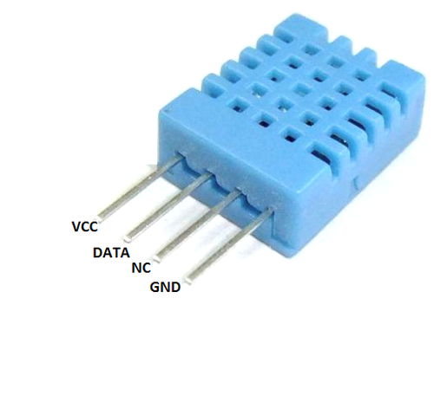
DHT Temperature sensor
The DHT sensors are made of two parts, a capacitive humidity sensor and a thermistor. There is also a very basic chip inside that does some analog to digital conversion and spits out a digital signal with the temperature and humidity.

Slide 5
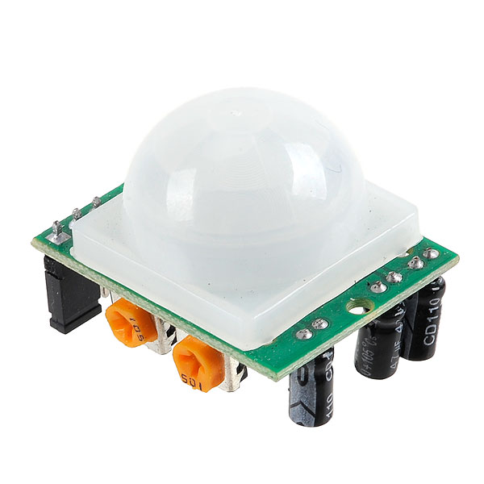
PIR Proximity senor
A passive infrared sensor (PIR sensor) is an electronic sensor that measures infrared (IR) light radiating from objects in its field of view. They are most often used in PIR-based motion detectors.

Slide 6
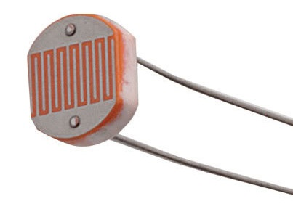
Light dependent resistor
An LDR is a component that has a (variable) resistance that changes with the light intensity that falls upon it. This allows them to be used in light sensing circuits

Slide 7

Software
Arduino ide
Blynk Android application
IFTTT software

Slide 8
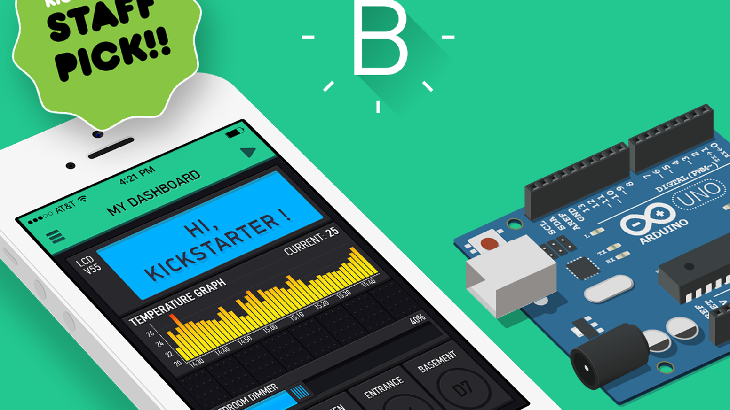
Blynk
It is an android application which connects your microcontroller with your smartphone over Wifi and allows you to control devices with android app.

Slide 9

IFTTT
It is another application which allows you to link your google account with Blynk application so that we can control devices with Google Android Assistant.

Slide 10

What we did?

Slide 11
We connected PIR sensor and DHT sensor to the digital and LDR to the analog pin of our Arduino board as input devices. We connected some LEDs and a motor fan to the digital pins of Arduino board as output pins.
So here, devices connected to input pins analyze the surrounding and send data to Arduino which processes it and command devices connected to output pins accordingly.
We also connected few devices to the digital pins of ESP8266 Node mcu board which we can access through wifi connection.

Slide 12

How it Works?

Slide 13
PIR proximity sensor gets HIGH input when it detects someone in the room and gets LOW input in empty room.
DHT sensor measures the temperature and humidity in the room.
If there is enough brightness in the room that we can read comfortably, LDR gets LOW and when there is insufficient light, it gets HIGH.

Slide 14
When someone enters the room, PIR sensor gets the input and sends it to Arduino which commands other sensors to get activated. Now DHT sensor measures the room temperature and if it is above 20 degrees, it tells Arduino to switch on motor fan otherwise if it is below 20 degrees, it tells Arduino to switch off motor fan. At the same time LDR measures brightness in the room and accordingly switch on or off LEDs. Finally when person leave the room or when there’s no one in the room, PIR detects it and commands motor fan and LEDs to be switched off irrespective of temperature or brightness in room.

Slide 15
We connected few devices with digital pins of Node-mcu board and recorded them. Then while configuring Node-mcu with Blynk app, we created simple on-off switch on same pins. Now using wifi, we can control these devices from Blynk app in our phone using the switches we created.
For connecting these switches with Google Assistant, we accessed these switches from Blynk app and connected them to Google Assistant using IFTTT as a linking software.

Slide 16
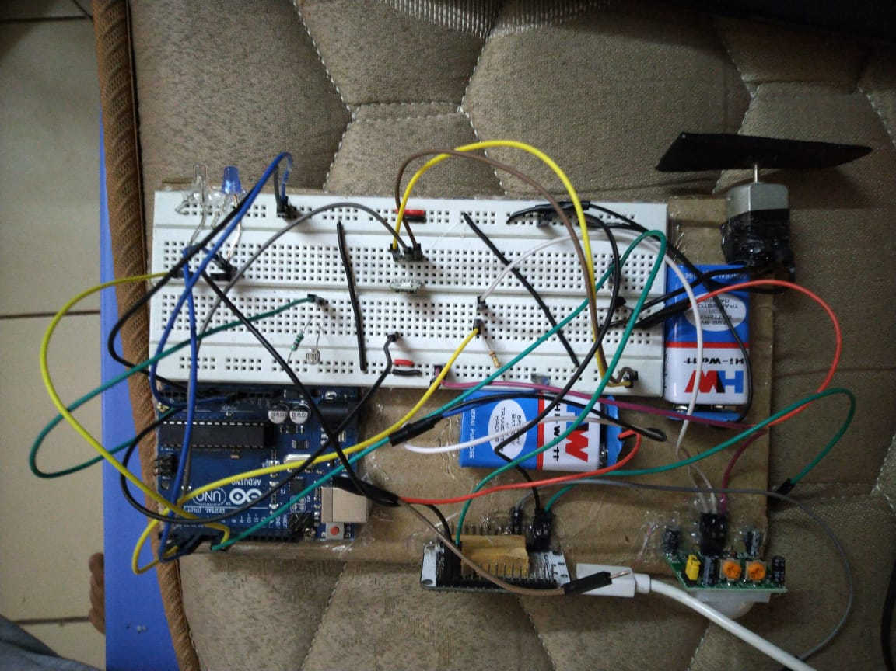

Slide 17

Shashank Gupta 17BEC0361
Sambhav Jain 17BEC0899
Aman Singh 17BEC0545
Shreya Singh 16BEC0598

